Slide 1

PHISHING URL’s PREDICTION
Tejesh Varma Rudraraju.

Slide 2

What are Phishing URL’s?
“Phishing” is when a hacker fishes for your private information.
A lot of customers utilize e-banking to pay for their online purchases of goods.
The hacker would mimic a known company, sending a bogus email with a message saying “Your account has been disabled. Click here to restore it.”

Slide 3
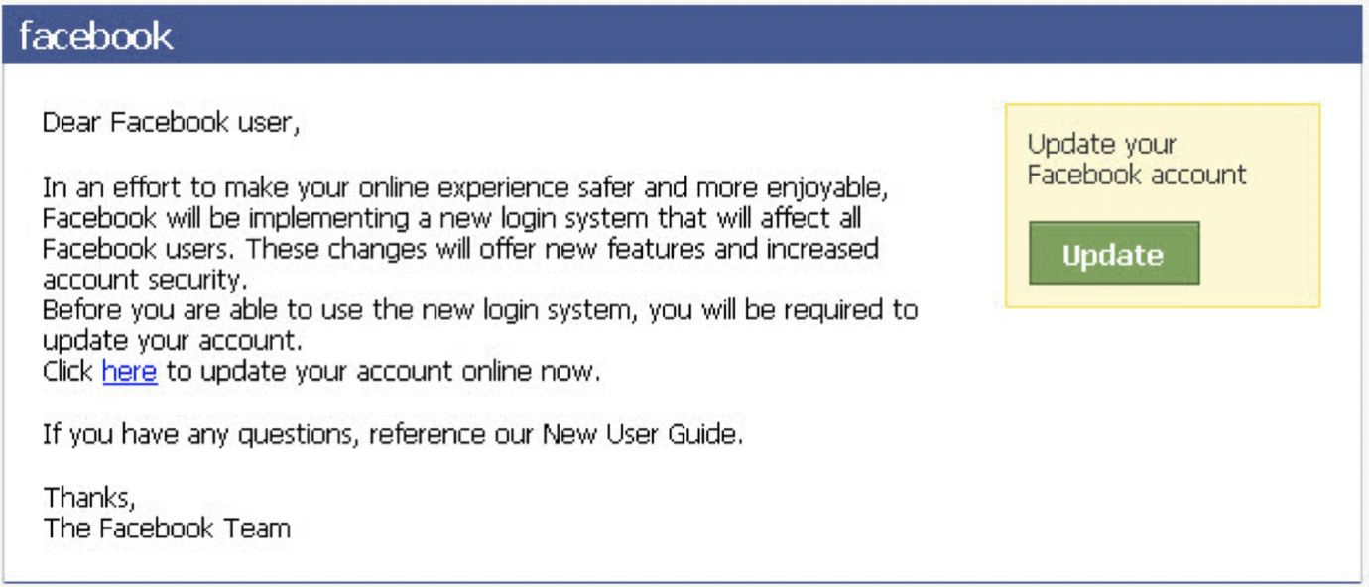
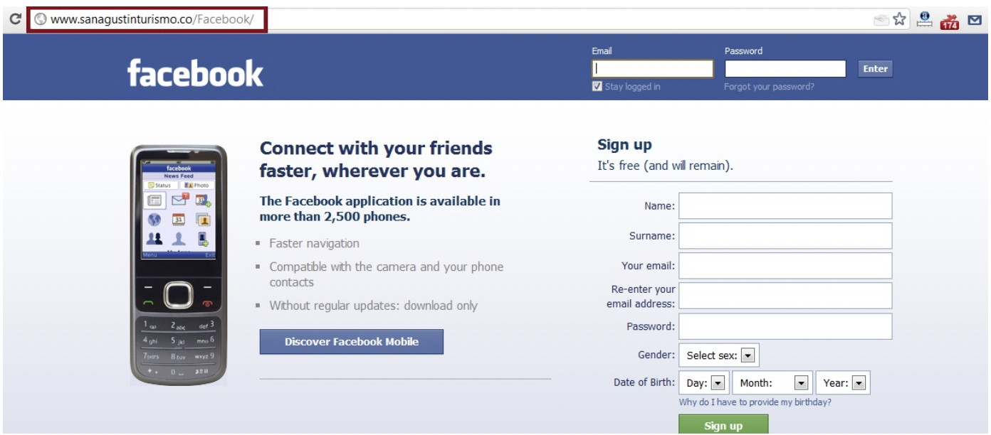

Slide 4
Common URL Phishing Techniques
Mixing legitimate links with malicious links
This is the most common way the hackers would use and the for example the email may contain links to pages on the irs.gov website but have a “click here to secure your account” button that leads to an illegitimate site.
Abusing Redirects
In this instance, users are directed to a legitimate webpage after giving their credentials or opening malicious software. This diverts them from thinking anything is awry.
Obfuscating Malware with Images
Many cyber criminals use images of text to hide malware from basic filters, which scan textual content. If the filters see an email with little to no text, they may mark it as safe without noticing the malware.

Slide 5
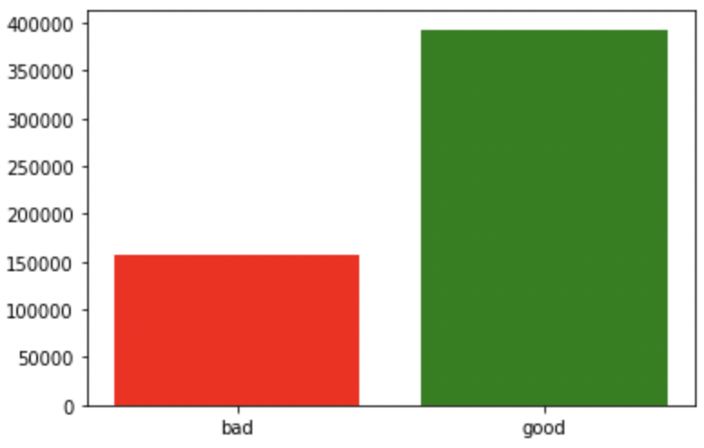
Data Description and Source
Source – Kaggle
https://www.kaggle.com/datasets/taruntiwarihp/phishing-site-urls
Data - 5,49,346
There are 2 columns –
URL and label
Label is further divided into good and bad based on the malicious stuff in the url.

Slide 6
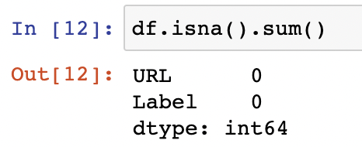
No null values in the dataset

Slide 7
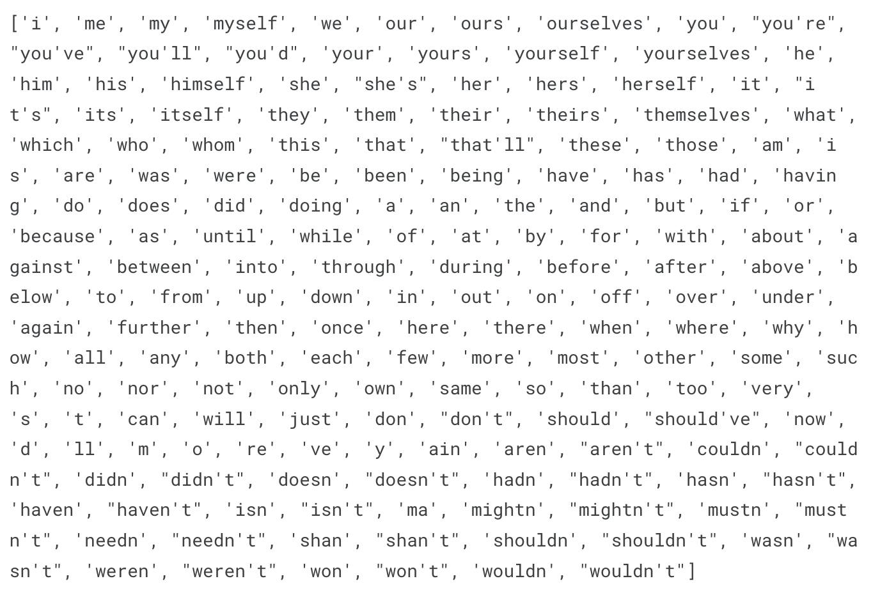
Checked and Removed duplicates – 42151 count
StopWords

Slide 8
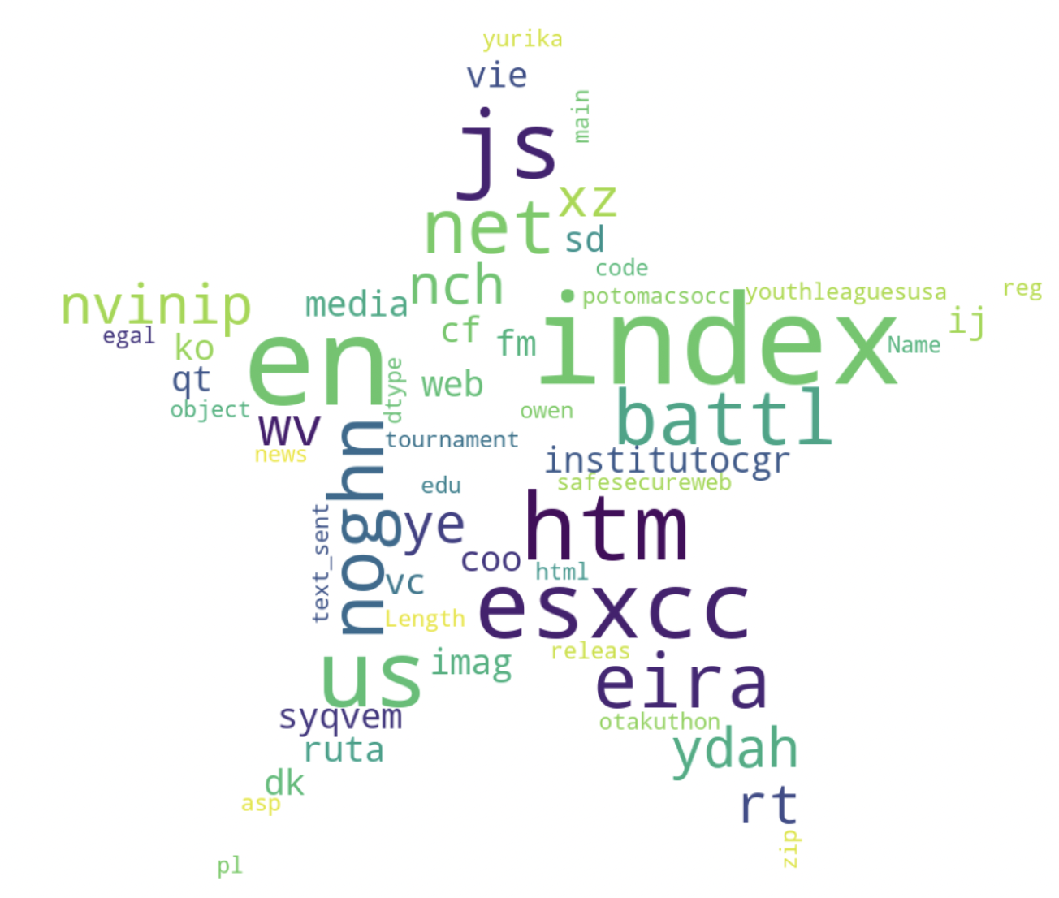
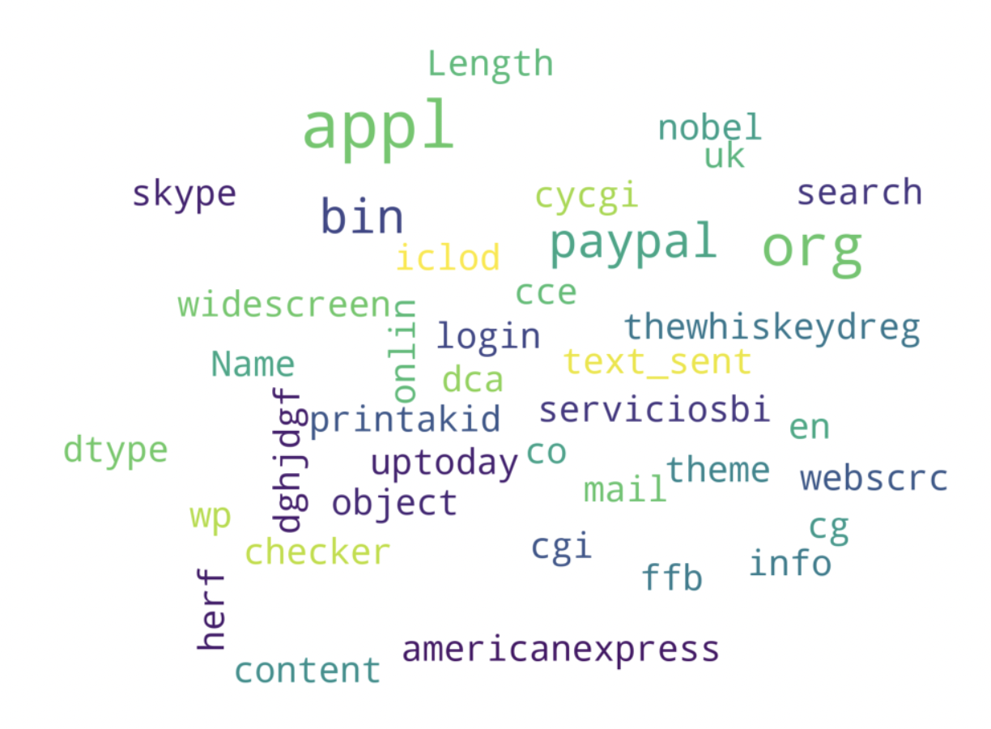
Word Cloud
Good URL
Bad URL

Slide 9
Lemmatization
Performed the Preprocessing
Vectorizing using TFIDF
Vectorizing using CountVectorizer

Slide 10
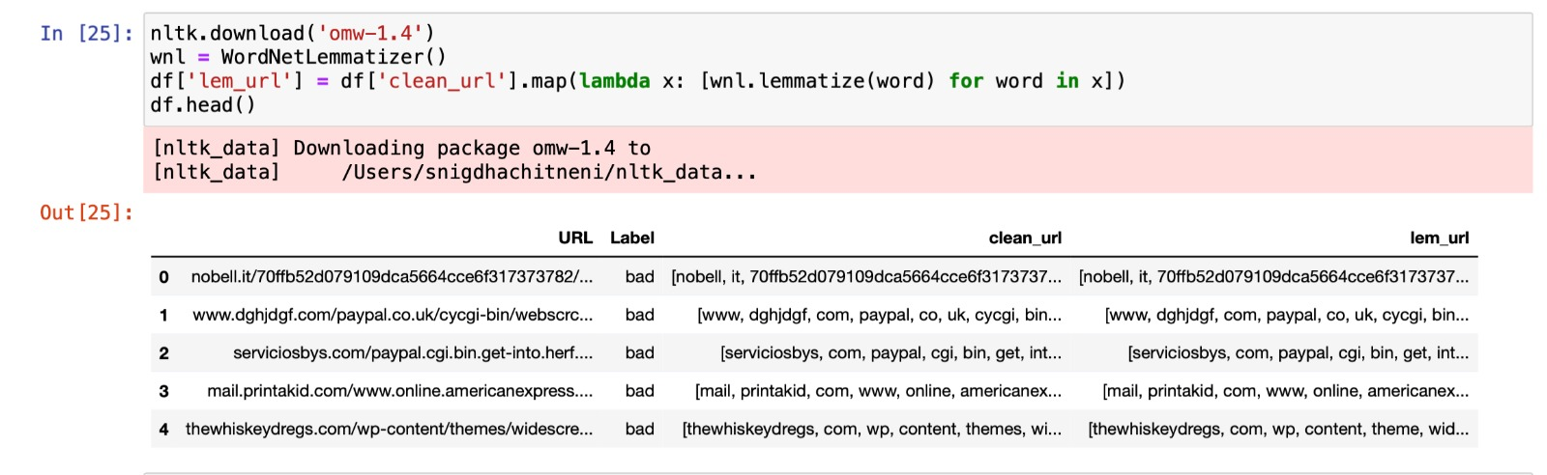
Lemmatization

Slide 11
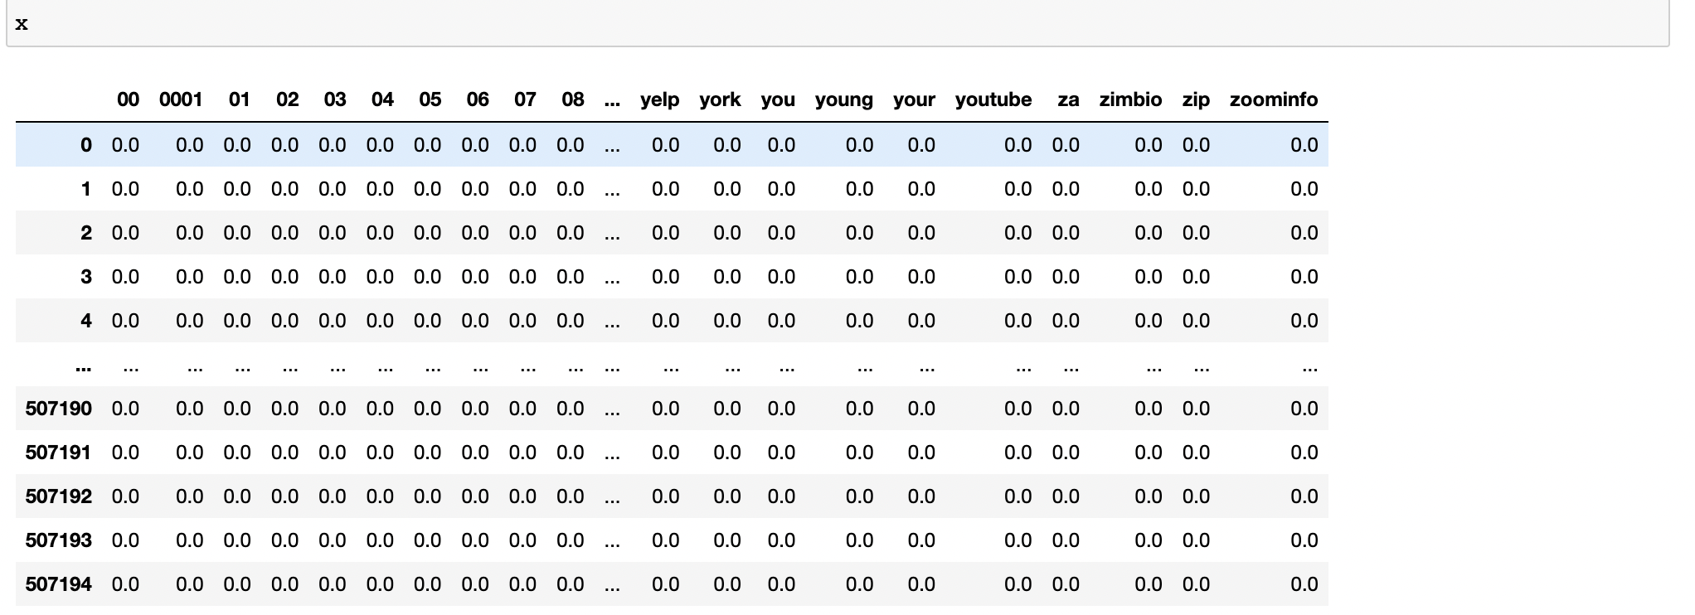
Vectorizing using tfidf

Slide 12
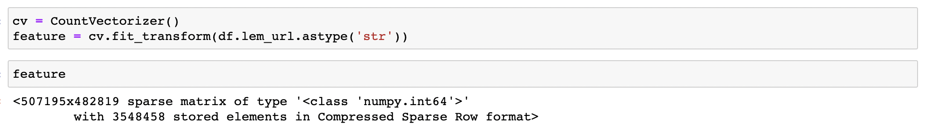
Vectorizing using Count Vectorizer

Slide 13
Research Questions
1. To create a classification model to identify whether a URL is a good or a bad URL.
2. To find whether there are any similarities in all bad URL’s.

Slide 14
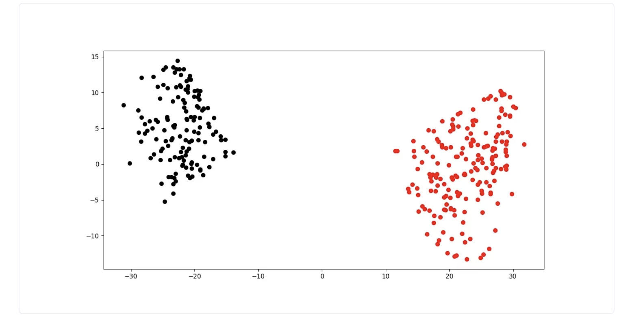
Clustering Using K-means
Red is bad URL tokens
Black is good URL tokens

Slide 15
Methodology
We used different classifications models to check the accuracy and other metrics to determine if the URL is good or bad
Naïve Bayes
Logistic Regression
Decision Tree

Slide 16
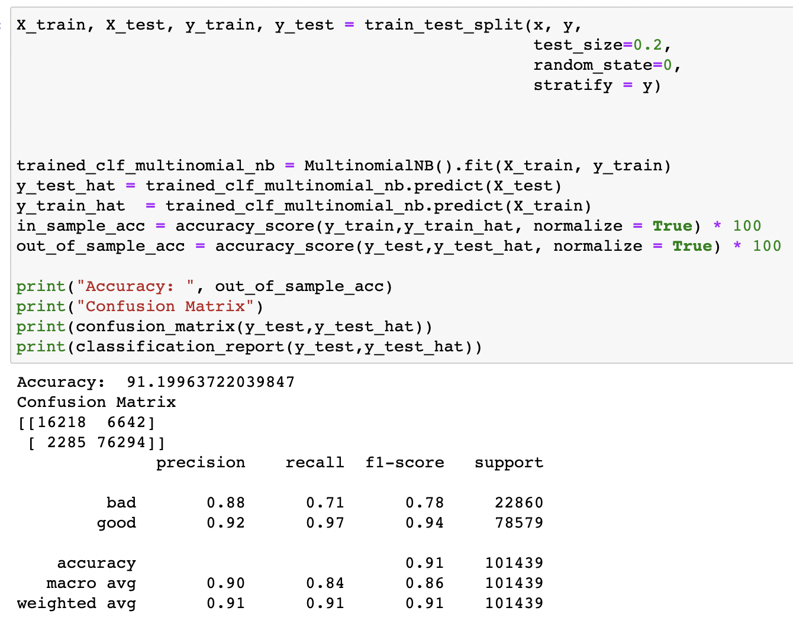
Naïve Bayes

Slide 17
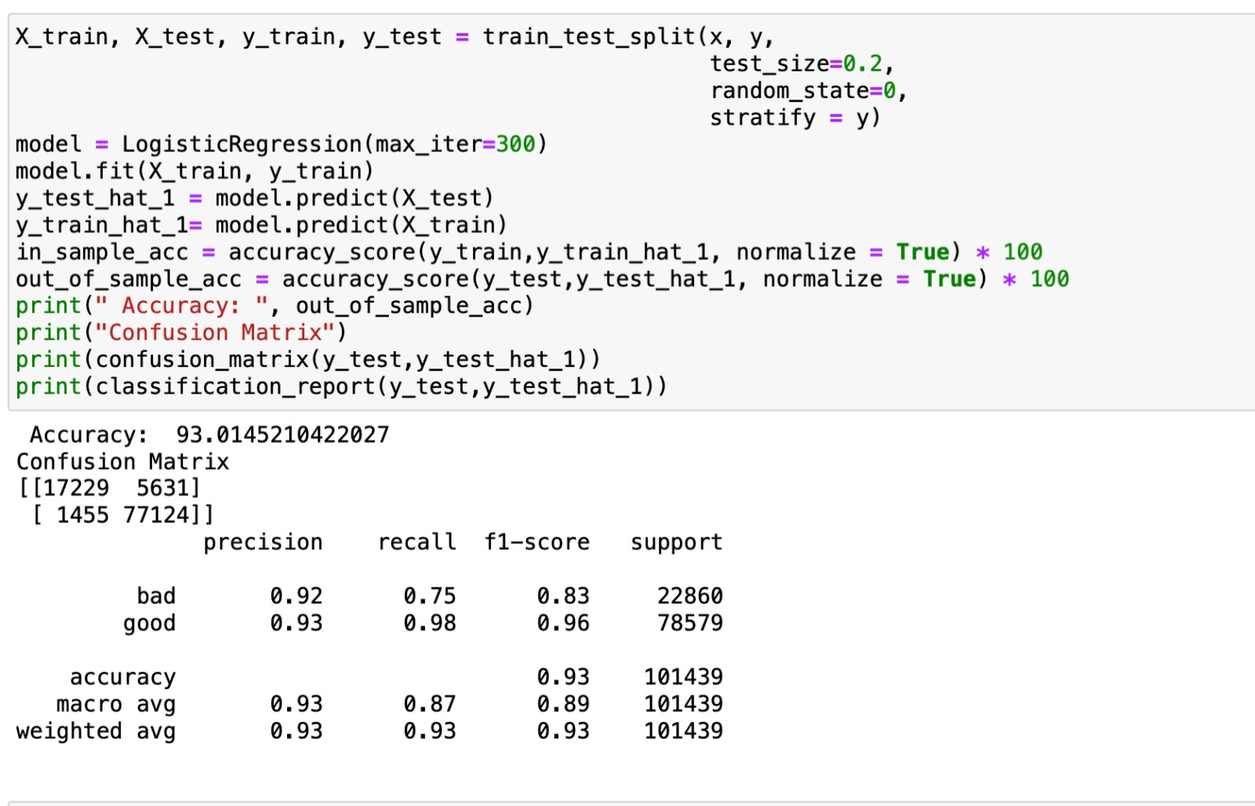
Logistic Regression

Slide 18
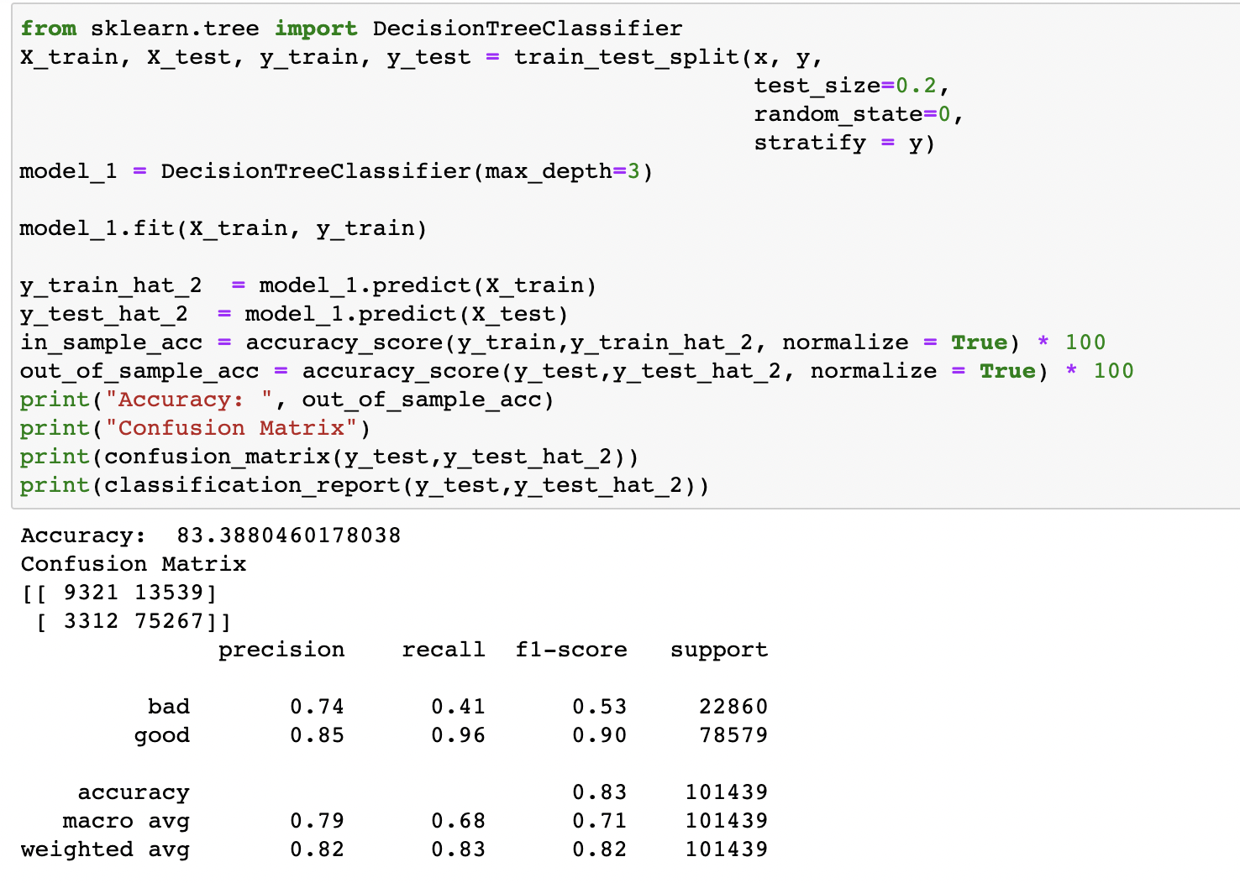
Decision tree

Slide 19
Results and Discussions
From the above results we can conclude that Logistic Regression gave us best accuracy of 93% so we chose it as the superior model among the rest
Our model helps the users to identify the bad URL’s successfully

Slide 20
Conclusions
The users can also identify the bad urls by following the below protocols
Consider the Source
Spellcheck the address
Vet that URL before you click
Investigate the website
Proofread that site
And if the user finds it as a bad URLS, they need to report it so the concerned officials would block or disable the URLS. Here’s the link phishing-report@us-cert.gov
UTA students can also report the bad Urls to the university at phish@uta.edu

Slide 21
Thank you

